Slide 1

Quantum Reservoir Computing on EEG Signals
Project for the course Quantum Machine Learning

Slide 2
MindBigData
Emotiv EPOC Hardware
Utilizes 14 channels sampling at 128Hz frequency.
Scope Limit
Focused strictly on digits 0–4 to establish a robust 5-class cognitive intent benchmark.
Feature Extraction
Extracted 112 classical statistical and frequency-domain attributes.

Slide 3
Reservoir & Readout Setup
Quantum Encoding
Maps the 112 extracted classical features onto an 8-qubit system.
Amplitude embedding projects the signals into a 256-dimensional Hilbert space.
Quantum Reservoir
Fixed, untrained Depth-3 quantum circuit acts as a non-linear mixer.
Transforms raw features into high-dimensional quantum states without parameter training.
Ridge Classifier Readout
Applied a classical Ridge Classifier to the measured qubit expectation values.
Only this classical readout head is trained, bypassing expensive quantum gradient descent.

Slide 4
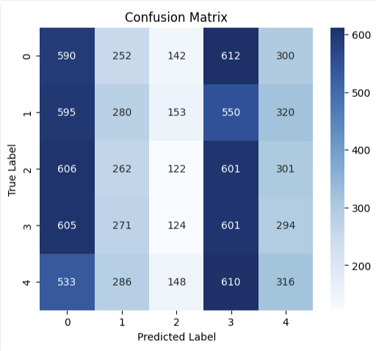
Experimental Results
Class Distribution: Visualizes the true vs. predicted classifications across all 5 cognitive intent classes (digits 0–4).
Bias Detection: Highlights a clear prediction tendency towards classes 0 and 3, which helps explain the performance bottlenecks in chaotic raw EEG data.
Model Validation: Accuracy remained close to the random guessing baseline.

Slide 5
Key Takeaways
Hardware Limits & Preprocessing
Raw, full-length EEG waveforms cannot be handled directly by current quantum systems because the required qubit count and circuit depth scale too rapidly.
While the 112 extracted features bypassed this bottleneck, close-to-baseline results indicate that mapping complex biological signals into Hilbert space requires more structured temporal embeddings.
Hybrid QRC Efficiency
Combining an untrained quantum reservoir mixer with a classical Ridge Classifier readout worked flawlessly from an execution standpoint.
Bypasses expensive quantum gradient descent entirely, offering a highly efficient pipeline for streaming and processing large datasets.

